Slide 1
Few shot clustering for indoor occupancy detection with extremely low-quality images from battery free cameras
Speaker: Homagni Saha
Committee: Jin Tian (major professor), Soumik Sarkar (major professor), and Ali Jannesari
04/15/2021
Notes:
Good afternoon and welcome to my talk on
Few shot clustering for indoor occupancy detection with extremely low-quality images
From battery free cameras

Slide 2
Outline
Introduction
Indoor Occupancy Detection
Vulnerabilities in indoor occupancy detection
Basic concepts
Few Shot Learning
Existing Frameworks
Siamese Neural Networks
Expectation Maximization concept
Few Shot Occupancy Detection Framework
Detailed Working Explanation
Framework summary
Application
Privacy Preserving Data Collection and Results
Benchmark comparison with other approaches

Slide 3
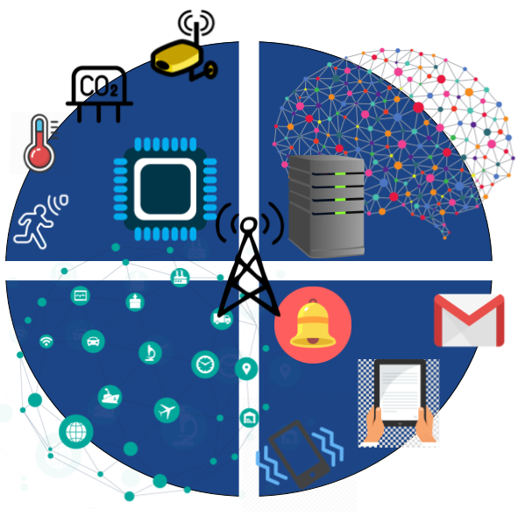
Indoor Occupancy Detection
Considers the set of all techniques used to collect data from relevant sensors in an indoor environment to detect, count or track human activity inside a given space
Reliable detection of human occupancy is critical for several applications namely:
Energy efficiency
Home automation
Appliance use monitoring
Security and safety applications
Notes:
https://smartoccupancydetector.wordpress.com/
(read from slide)

Slide 4
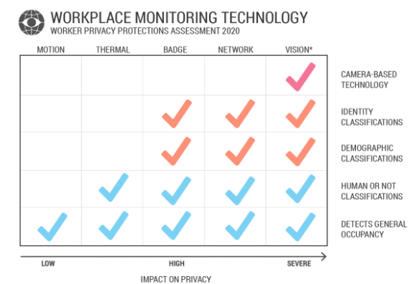
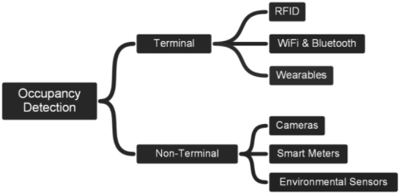
Vulnerabilities in occupancy detection (1/3)
Notes:
https://www.mdpi.com/1424-8220/18/11/3953/htm
https://medium.com/coworkr/worker-privacy-e227b47c8f6
A plethora of techniques have been previously used for human occupancy detection ranging from environment sensors such as CO2, humidity to motion based such as infrared, ultrasonic, pressure sensitivity based and even WiFi based.
Each of the techniques have their own advantage and disadvantages.
Passive sensing technologies are in general cheap and easy to deploy and respect occupant privacy, however they tend to accumulate errors easily, are not flexible enough for changing task requirements and might often require periodic replacement.
Image based occupancy sensing on the other hand promise improved occupancy detection by leveraging state of the art deep learning algorithms that have achieved massive success in object detection in the recent years. However, their major concern is privacy.

Slide 5
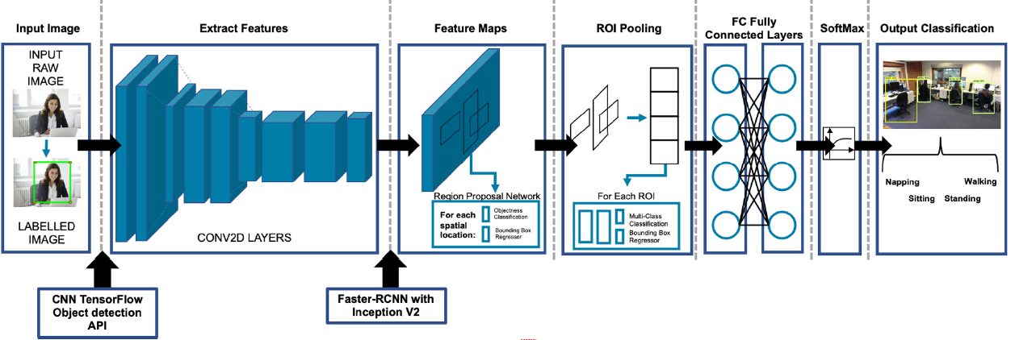
Vulnerabilities in occupancy detection (2/3)
Example convolutional neural network-based occupancy detection framework that requires lots of privacy infringing data
Notes:
http://www.sdewes.org/jsdewes/pid8.0378
Another concern while deploying machine learning models in such scenarios is the tradeoffs between model complexity, deployment cost and model performance.
Sophisticated object detection models can provide better accuracies but are costlier to deploy. For specific scenarios they might need to be trained for the same image settings as that in deployment which requires us to collect scenario specific data which increases labeling cost, while infringing upon privacy of occupants.

Slide 6
Vulnerabilities in occupancy detection (3/3)
Sophisticated model
Higher deployment costs
Deployment specific training data ?
Simple model
Lower performance
Notes:
In such cases we might go for simpler architecture image recognition models which are not general enough to work in many situation, but are easier to deploy, but they would still need scenario specific labeled data to train upon.
So do we still have to collect tons of deployment specific labeled data?
In this presentation we will discuss another approach to this problem by developing a few shot clustering algorithm that can adapt to a variety of deployment scenarios but also require very less labeled data in the order of single digits

Slide 7
Contribution
We propose a few shot learning framework that enables relatively simpler convolutional neural network (CNN) architectures for indoor human occupancy detection that works on extremely low-quality images
We present a few shot clustering technique as an on-line adaptation approach for the indoor occupancy detection framework.
We demonstrate our algorithm on images captured by a low-cost battery free camera hardware and release the images as a new publicly available dataset
Notes:
(click)
We propose a few shot learning framework that enables relatively simpler convolutional neural network (CNN) architectures for indoor human occupancy detection that works on extremely low-quality images
(click)
We present a few shot clustering technique as an on-line adaptation approach for the indoor occupancy detection framework.
In our framework, users only need to provide a few starting images to set the semantics for clustering
and then the algorithm learns to cluster instances into occupied and unoccupied classes
in an unsupervised fashion from streaming videos under various situations
(click)
We demonstrate our algorithm on images captured by a low-cost battery free camera hardware and release the images as a new publicly available dataset

Slide 8
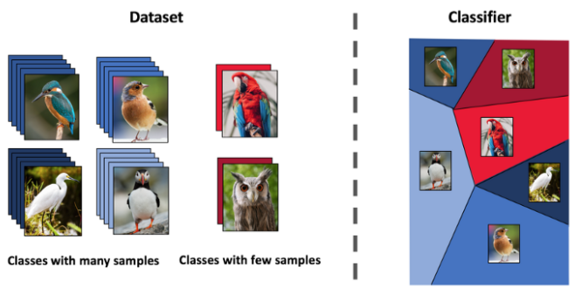
Few Shot Learning
Very small amount of training data
Classifying rare species of birds from just a few examples
Major paradigms
Data level paradigm
Parameter level paradigm
Notes:
https://medium.com/sap-machine-learning-research/deep-few-shot-learning-a1caa289f18
(click)
The name few shot refers to the practice of feeding a deep learning model with very small amount of training data, which is contrary to the normal practice of using large amounts of data
(click)
For example, if we have a problem of categorizing bird species from photos, some rare species of birds may lack enough pictures to be used in the training images.
(click)
Generally, there are two major paradigms when employing few shot learning- one is data level and the other is parameter level.
For data level, the approach is based on the concept that
whenever there is insufficient data to fit the parameters of the algorithm
and avoid underfitting or overfitting the data, then more data should be added.
For example, if the intention is to create a classifier for the species of birds without sufficient
labeled elements for each category, it could be necessary to investigate other
external data sources that have images of birds.
Parameter level approaches are also known as meta learning approaches. the algorithm is
taught to go for the best route in the parameter space to give optimal prediction results.
For example, a teacher algorithm can be trained using a big quantity of data on how to encapsulate
the parameter space. Thereafter, if the real classifier (student) is trained, the teacher algorithm
directs the student on the extensive parameter to realize the best training results.

Slide 9
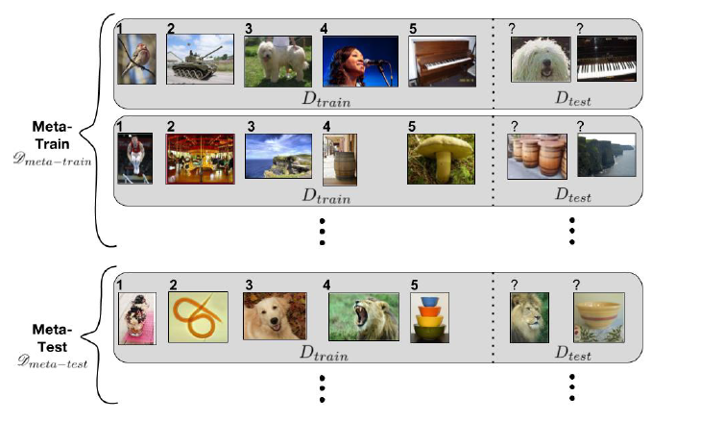
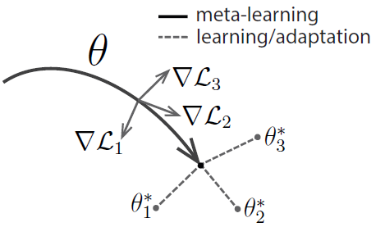
Overview of existing approaches (1/3)
Meta Learning Strategy [1,2]
[1] Ravi, Sachin, and Hugo Larochelle. "Optimization as a model for few-shot learning." (2016).
[2] Finn, Chelsea, Pieter Abbeel, and Sergey Levine. "Model-agnostic meta-learning for fast adaptation of deep networks." International Conference on Machine Learning. PMLR, 2017.
Notes:
Now we will go through a brief overview of existing types of few shot learning frameworks.
First, we have the meta learning strategy.
These frameworks follow the parameter level paradigm as we have mentioned earlier.
Here a task-based learning strategy is followed where a meta training dataset would contain a large number of different image classification tasks.
Each task contains a small number of representative images which the leaning model can use to learn how to classify images.
As summarized by the figure on the right, the goal with these kind of learning approaches is to learn such a set of model parameters theta,
Which is very easily tunable to any of the different classification tasks 1,2 or 3 only by training on just a few images.

Slide 10
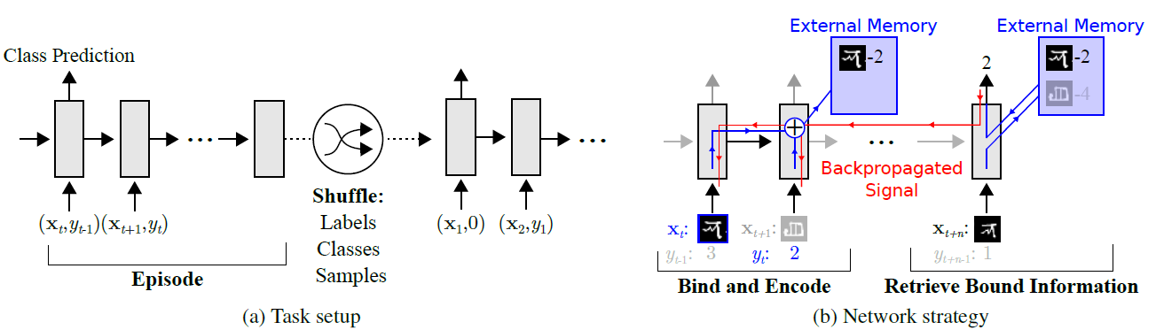
Overview of existing approaches (2/3)
Meta Learning with augmented memory [3]
[3] Santoro, Adam, et al. "Meta-learning with memory-augmented neural networks." International conference on machine learning. PMLR, 2016.
Notes:
Next, we also have the meta learning with augmented memory base approaches.
Here the classification task is set up in a sequential manner.
The model is shown an image at time t, but the provided corresponding label may be offset to the label from a few time steps earlier or a few time steps later
The expectation is that the model learns to encode the shown image into an external memory
so that next time when a similar image is shown it can simply recall the label from the external memory

Slide 11
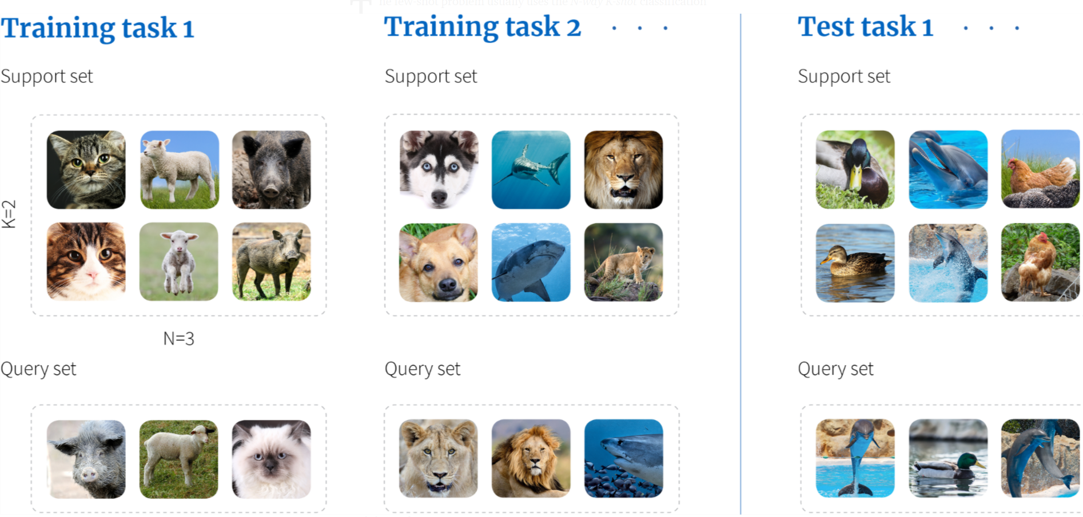
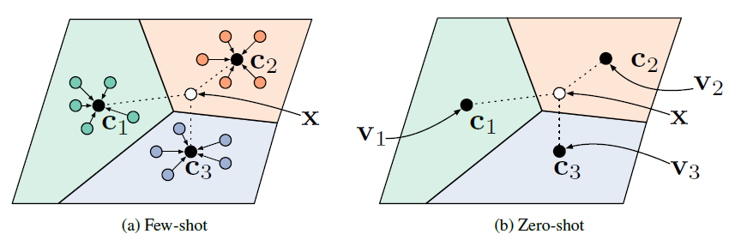
Overview of existing approaches (3/3)
Metric Learning approaches [4]
[4] Snell, Jake, Kevin Swersky, and Richard S. Zemel. "Prototypical networks for few-shot learning." arXiv preprint arXiv:1703.05175 (2017).
Notes:
Finally, we have the metric or embedding learning approaches.
Our approach is closest to the metric learning approach.
In these kind of techniques, for the training data, the neural network model has access to images in a so-called support set
The goal is for the neural network to map groups of images into similar compressed embeddings.
Groups of these embeddings can be visualized as clusters C1,C2,C3 and so on.
The images on which inference has to be performed is called the query set. The neural network model
Maps the query set as an embedding at a particular location in the embedding manifold.
After that the class of the image in the query set is assigned based on the relative distance from the center of the clusters.

Slide 12
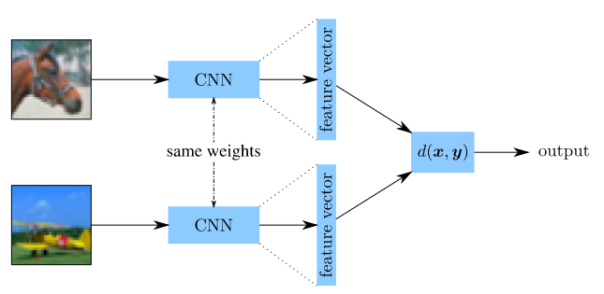
Siamese Convolutional Neural Network
Two shared parameter convolutional neural network blocks
Designed to accept two distinct images
Jointly represent a metric d(x,y) for the images x and y
The metric can convey several different aspects about the pair of images
Schematic of Siamese Convolutional Neural Network
Notes:
Now we will talk about a neural network architecture called Siamese Convolutional Neural Network
The Siamese Convolutional Neural Network Consists of two shared parameter convolutional neural network blocks each convolution block is a
Series of alternating convolution and maxpooling) (click)
It is Designed to accept two distinct images Each Convolutional block transforms a 2-dimensional multi channel image into a 1-dimensional feature vector (click)
The two different feature vectors can be optimized to jointly represent a metric d(x,y) for the images x and y (click)
The metric can optimized for a variety of different applications such as degree of similarity or dissimilarity between
two images or even perceived motion about the same object across two different images
Which can be used for pose estimation and optical flow

Slide 13
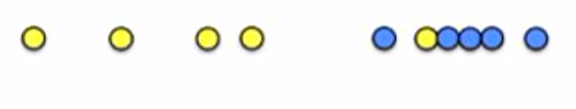
Concept of Expectation Maximization (1/3)
Step 0: Without perfect knowledge, assume the set of points originated from 2 different gaussian probability distributions. Start with random guess ${(μ}_{y},{σ_{y}}^{2})$, ${(μ}_{b},{σ_{b}}^{2})$
x
Notes:
https://towardsdatascience.com/expectation-maximization-explained-c82f5ed438e5
Now we are going to talk about a simple 1-dimensional data example and briefly cover the concept of Expectation maximization algorithm which is a major component of our clustering technique
Suppose we have a set of points on the x axis, with the underlying distribution yellow and blue as visualized in the figure.
We want to the cluster these points into 2 clusters without the knowledge abut which point came from the blue and which point came from the yellow
So step 0 (click) (read) (click)

Slide 14
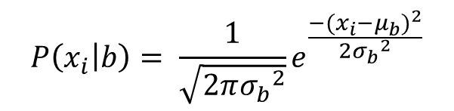
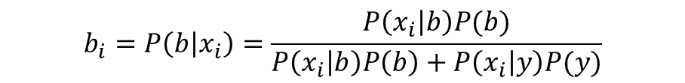
Concept of Expectation Maximization (2/3)
Step 1: (E step) For each point, calculate the probability of the point belonging to one of the clusters.
$$P\left(x_{i} | b\right)= \frac{1}{\sqrt{2π{σ_{b}}^{2}}}e^{\frac{−{(x_{i}−μ_{b})}^{2}}{2{σ_{b}}^{2}}}$$
x
$$b_{i}=P\left(b | x_{i}\right)=\frac{P\left(x_{i} | b\right)P(b)}{P\left(x_{i} | b\right)P\left(b\right)+P\left(x_{i} | y\right)P(y)}$$
Soft assignment (based on equal priors)
Notes:
Next, we enter the E-step in which we calculate the probability of each point belonging to one of the clusters.
What is the probability that the point has been sampled from the blue cluster
And what is the probability that the point has been sampled from the yellow cluster,
We can calculate those from the current model parameters.
After that we perform soft assignment utilizing Bayes rule to assign a score to each point.
We can think of it like assigning a partial coloring of part blue and part yellow to each point

Slide 15

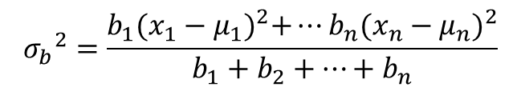
Concept of Expectation Maximization (3/3)
Step 2: (M step) Based on the assigned probabilities, re-estimate the parameters of the underlying Gaussian probability distribution. If not converged go back to step 1.
x
$$μ_{b}=\frac{b_{1}x_{1}+b_{2}x_{2}+…+b_{n}x_{n}}{b_{1}+b_{2}+…+b_{n}}$$
Estimation
$${σ_{b}}^{2}=\frac{b_{1}{(x_{1}−μ_{1})}^{2}+…b_{n}{(x_{n}−μ_{n})}^{2}}{b_{1}+b_{2}+…+b_{n}}$$
Notes:
Finally in the M step, based on the assigned posteriors in the previous step, we re-estimate the
Parameters of the underlying Gaussian distributions.
Step 1 and 2 are repeated in a cyclic fashion until some convergence criteria is met.

Slide 16
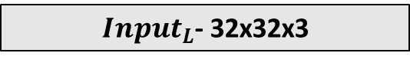
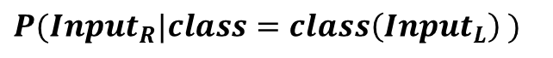
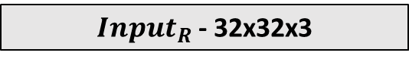
Siamese Architecture
$Input_{L}$- 32x32x3
$Input_{R}$- 32x32x3
Conv (2x2)- 32 filters
Conv (2x2)- 32 filters
Conv (2x2)- 32 filters
Conv (2x2)- 32 filters
Maxpool (2x2)
Maxpool (2x2)
Conv (2x2)- 64 filters
Conv (2x2)- 64 filters
Conv (2x2)- 64 filters
Conv (2x2)- 64 filters
Maxpool (2x2)
Maxpool (2x2)
Conv (2x2)- 128 filters
Conv (2x2)- 128 filters
Flatten + Dropout (p = 0.2)
Flatten + Dropout (p = 0.2)
Absolute difference
MLP
$$P(Inp{ut}_{R}|class=class\left(Inp{ut}_{L}\right) )$$
Notes:
This is the Siamese network architecture we are using as the
non linear approximators for the underlying class distributions
It is relatively much simpler compared to state of art object detector frameworks
It consists of a bank of two 32 by 32 convolution filters followed by maxpool
Then 2 blocks of 64 by 64 followed by a maxpool and then a 128 filter block
Finally followed by a flatten to convert the 2d features into a 1d feature vector
With a 20% dropout regularization in the end
The input blocks are designated input_l and input_r depending on the type of image being
Input which will become clear as we progress though the slides
After input_l and input_r passes through both the blocks we use an
absolute difference of the two feature vectors to get a final feature vector
The final feature vector is passed through a 3 layer fully connected block
With a final output size of 1
Which is supposed the predict the probability of encountering
Input_r given the class of input_r has to be the same as the class of input_l

Slide 17













Few Shot Clustering Framework
Labeled Set
Unlabeled Set
Notes:
Now we combine concepts from Siamese Neural Networks and the E-M algorithm to create a framework for few shot clustering
We will go through an interactive step by step example that will demonstrate how our algorithm works.
Suppose in a very simple scenario we must learn the difference between images of 0 and images of 1.
For this purpose, say, we have a labeled set shown in the left-hand box, which contains 2 examples of images of 0 and 2 examples of images of 1
On the right hand box, we have an unlabeled set of total of 10 unlabeled images,
5 of the image 0 and 5 of the image 1, which must be clustered into 2 classes

Slide 18
Few Shot Clustering Framework
Form Pairings
Notes:
As a first step we form exhaustive pairings with each image in the labeled set to each image in the unlabeled set
In here we are pairing one labeled example from the 0 class to 5 unlabeled example in the 0 class

Slide 19
Few Shot Clustering Framework
Form Pairings
Notes:
Similarly, In here we are pairing one labeled example from the 0 class to 5 unlabeled example in the 1 class.
This process is continued until all possible pairings have been formed.
In this specific case, we will have 2 times 2 times 10, equal to 40 possible pairings

Slide 20
Few Shot Clustering Framework (E-step)
Pairing Table
Notes:
After we have formed all the possible pairing, we get a pairing table like this
Along each row, the left image is the same labeled image
Along each column, the right image is the same unlabeled image.
(click)
Now we take each pair of images from the pairing table (click)

Slide 21
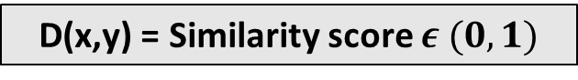
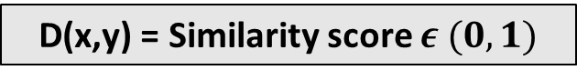
Few Shot Clustering Framework (E-step)
Convolutional Encoder
Convolutional Encoder
Convolutional Encoder
Convolutional Encoder
D(x,y) = Similarity score $ε (0,1)$
D(x,y) = Similarity score $ε (0,1)$
(Expected value close to 1)
(Expected value close to 0)
Notes:
And pass them through the Siamese Convolutional Neural network. The output features of both the encoders are
then mapped to a single value D(x,y) between 0 and 1 which is optimized to represent the degree of similarity between the pair of images.
(click)

Slide 22
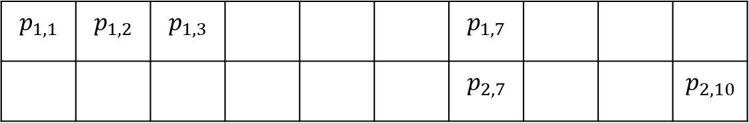
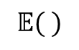
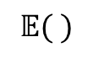
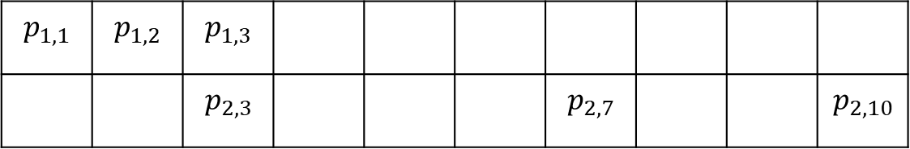
Few Shot Clustering Framework (E1-step)
Class 0
Unlabeled images (R)
$$𝔼( )$$
$$P(Inp{ut}_{R7}|class=class\left(Inp{ut}_{L7}\right)=0 )$$
Labeled images (L)
$$p_{1,1}$$ | $$p_{1,2}$$ | $$p_{1,3}$$ |  |  |  | $$p_{1,7}$$
 |  |  |  |  |  | $$p_{2,7}$$ |  |  | $$p_{2,10}$$
Class 1
Unlabeled images (R)
$$𝔼( )$$
$$P(Inp{ut}_{R3}|class=class\left(Inp{ut}_{L3}\right)=1 )$$
Labeled images (L)
$$p_{1,1}$$ | $$p_{1,2}$$ | $$p_{1,3}$$
 |  | $$p_{2,3}$$ |  |  |  | $$p_{2,7}$$ |  |  | $$p_{2,10}$$
Notes:
Finally for each similarity metric value calculated for a pair of images, we can again arrange then in form of
two probability tables for the two classes, pij denoting the probability value for each possible pairing
We get a table where each image from the labeled set is from class 0, and (click)
And a table where each image from the labeled set is from the class 1
For each table, along the rows the values correspond to the same paired labeled image
And along the columns the values correspond to the same paired unlabeled image
Now we take the expected value of each column in the tables for class 0 and class 1 (click)
Here an example is shown
For the 7th column in the table for class 0, taking the column average
Tells us what is the probability of encountering an image like the unlabeled image
at the 7th index given the class is the same as the class of the paired labeled image which is 0
Similar example is shown for the class 1 image at the 3rd unlabeled index

Slide 23
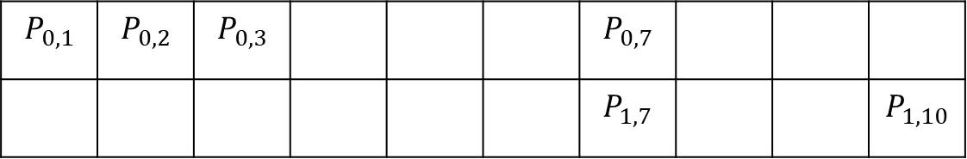
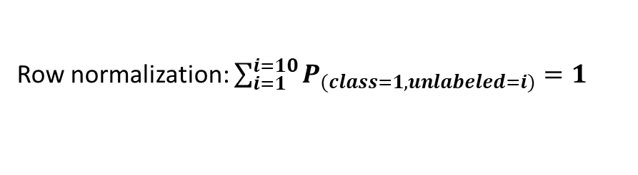
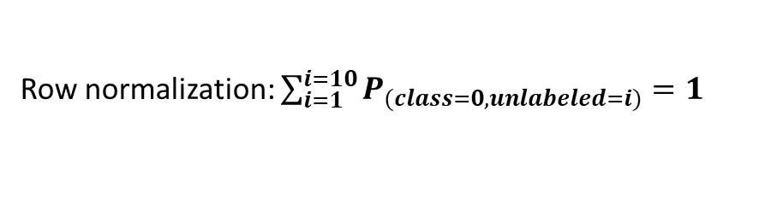
Few Shot Clustering Framework (E1-step)
Unlabeled images
Individual classes
Row normalization: $\sum_{i=1}^{i=10}{P_{(class=0, unlabeled=i)}}=1$
Class 0
$$P_{0,1}$$ | $$P_{0,2}$$ | $$P_{0,3}$$ |  |  |  | $$P_{0,7}$$
 |  |  |  |  |  | $$P_{1,7}$$ |  |  | $$P_{1,10}$$
Class 1
Row normalization: $\sum_{i=1}^{i=10}{P_{(class=1, unlabeled=i)}}=1$
Notes:
After doing the column expectations in previous slides, now we table a single table
where each row corresponds to each unique class
And each column corresponds to an unique unlabeled image
Now we do a row normalization along each row (click)
This will force the values along each row to add up to 1
After the row normalization we are ready for the soft assignment step

Slide 24
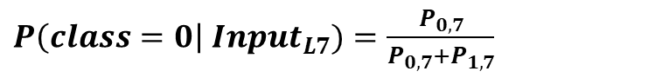
Few Shot Clustering Framework (E2-step)
Unlabeled images
Individual classes
Class 0
$$P_{0,1}$$ | $$P_{0,2}$$ | $$P_{0,3}$$ |  |  |  | $$P_{0,7}$$
 |  |  |  |  |  | $$P_{1,7}$$ |  |  | $$P_{1,10}$$
Class 1
. . . . .
Soft assignment
$P\left(class=0\right| Inp{ut}_{L7})=\frac{P_{0,7}}{P_{0,7}+P_{1,7}}$
Notes:
(click)
Finally in the soft assignment step we assign a soft label to each unlabeled image in the pairings
This can be done by applying this simple equation along each column of the table (click)
This reduces the table to a single row corresponding to soft labels for each unlabeled image

Slide 25
Few Shot Clustering Framework (M-step)
In the M step for the framework, we simply train the Siamese neural network on the fictitious soft assignments that we obtained in the E-step to maximize the probabilities that predict similar and/or dissimilar images
Log softmax + Negative Log Likelihood loss function is used to backpropagate the loss using Adam optimizer
Alternatively, in pytorch cross entropy could be used directly before application of log softmax
Use very low learning rate around 1e-7
Notes:
(Read)

Slide 26
Light Pretraining Step
Convergence is generally achieved after earlier mentioned E and M steps
However, during clustering, it is possible to arrive at undesirable clusters.
For example, in the case of occupancy detection images may be clustered based on similarity in image lighting conditions rather than occupied or unoccupied status
Therefore, before start of the E-M step, if we have n labeled images, the Siamese Convolutional Network is trained in a supervised fashion on nxn exhaustive pairs of examples for a small number of epochs, much smaller than number of E and M steps.
Notes:
(read)

Slide 27
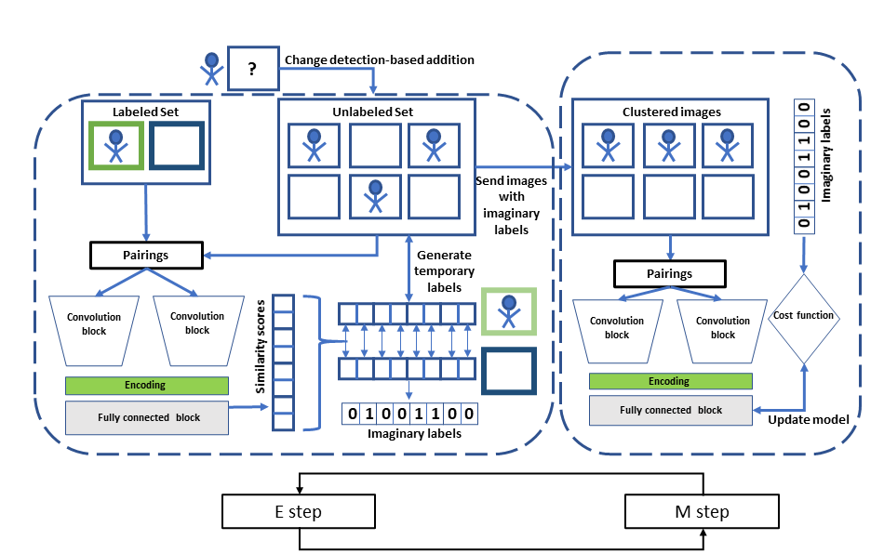
Framework application for occupancy detection
5
1
2
3
4
Notes:
The previous walk through was based on the MNIST images of 0 and 1.
Using the exact same technique, we can now apply this framework for indoor occupancy detection
First, we assign 3 memory locations, the labeled set where we pick at most 5 instances of
occupied and unoccupied example images where the camera is placed
We initialize an empty Unlabeled set where images are collected from the camera and stored over time
And we initialize an empty clustered images folder where the model segregates the images
in the unlabeled image in a continuous online fashion.
First we sample a pair that of a random image in the labeled set and a
random image in the unlabeled set and send them to a Siamese convolutional neural network. (click)
The Siamese Neural network architecture that we presented earlier now takes this pair
As input and predicts the degree of similarity between the two images on a scale of 0 to 1. (click)
This relative score is then used to assign an imaginary label to the image sampled from unlabeled set.
Images sampled from the unlabeled set with their labels assigned are send out to the clustered folder (click)
In the final step, an image pair is now sampled from the clustered set and the same Siamese neural
network is now trained to output 1 if the imaginary labels are same and 0 if the imaginary labels are not same.
Over time, we have verified using different combinations of true labeled images in the test set,
that our algorithm can assign correct clusters in the clustered images set from unlabeled images provided in the unlabeled set. (click)
As a final detail, instead of blindly adding images collected at each time step to the unlabeled set
We can also use simple change detection algorithms that detect the change from previous frame,
For example, detect the change in SSIM values from past image and add it if significant (click)

Slide 28
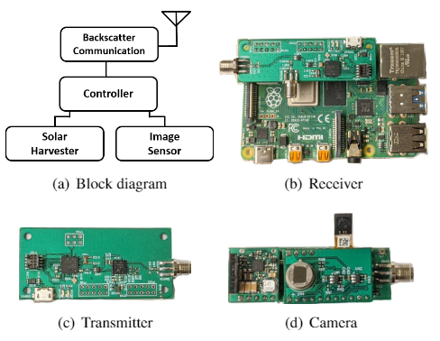
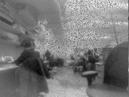
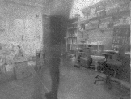
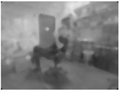
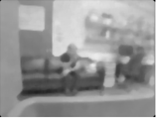
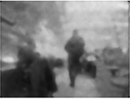
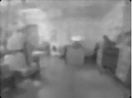
Dataset Collection
Data collected over different rooms with different positions and light settings
Notes:
For this project we had partnered with University of Washington and they had designed
these wireless battery free devices that use backscatter technology to collect low resolution
Images with little energy requirement as shown in the left figure.
On the right example images of occupied and unoccupied instances in our dataset are shown

Slide 29
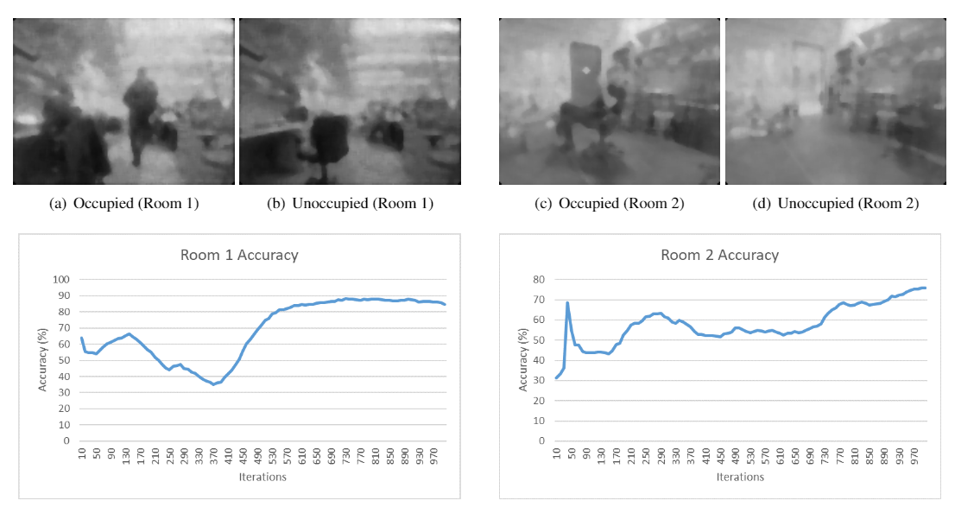
Algorithm training results (1/2)
Notes:
In this slide and the next we show examples of the clustering in work in 4 different office settings. The 32x32 pixel images are collected with the same data quality and camera position as shown in the pictures.
We use the pictures shown here as the starting labeled images and are maintained as the only labeled images for those regions.
After the light pretraining step, in a couple of scenarios we saw the clustering accuracies start close to 60%, over time when the EM algorithm progress, the accuracies dip initially, probably because the
rate at which the room changes from occupied to unoccupied is not uniform. However, after about 2 hours of data collection, the clustering accuracy in all the rooms starts to rise
Eventually after 4-5 hours the accuracy remains stable close to 80%.
By aggregating occupancy status across various rooms where camera are set up even higher occupancy detection close to 95% have been achieved by our team.

Slide 30
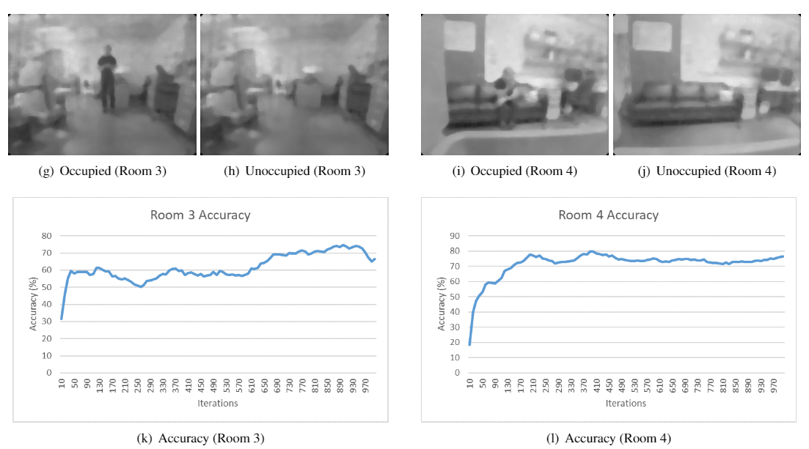
Algorithm training results (2/2)
Notes:
Ans this is another example of the two other scenarios we have used our clustering algorithm.

Slide 31
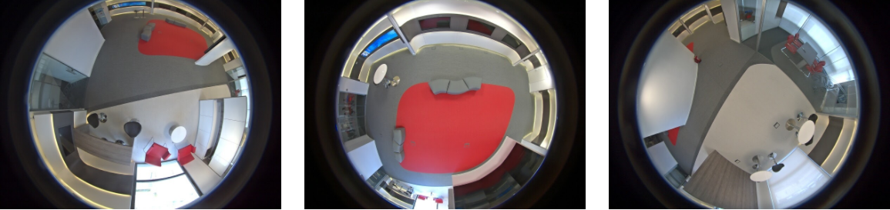
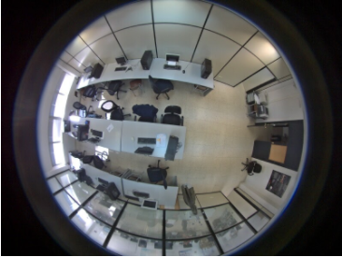
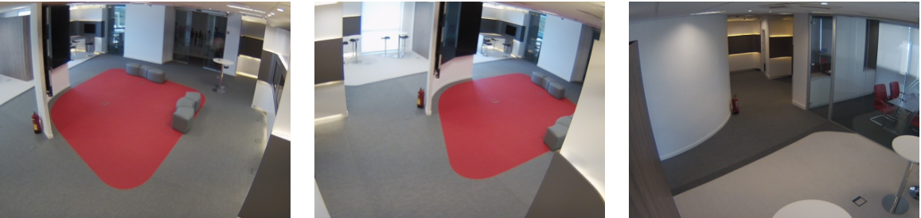
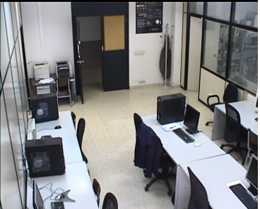
PIROPO Indoor Occupancy Detection Dataset [5]
[5] https://sites.google.com/site/piropodatabase/
Notes:
In order to verify that our algorithm also works in drastically different image settings and with better image data qualities we also used the publicly available dataset PIROPO
Which stands for - People in Indoor ROoms with Perspective and Omnidirectional cameras. It has been widely used by several earlier papers in presenting their occupancy detection systems
On the top row you can see that there are images collected from the top of the room using omnidirectional cameras
On the bottom row they have also used regular cameras to collect data from the same rooms. There can be upto 10 people simultaneously walking.

Slide 32
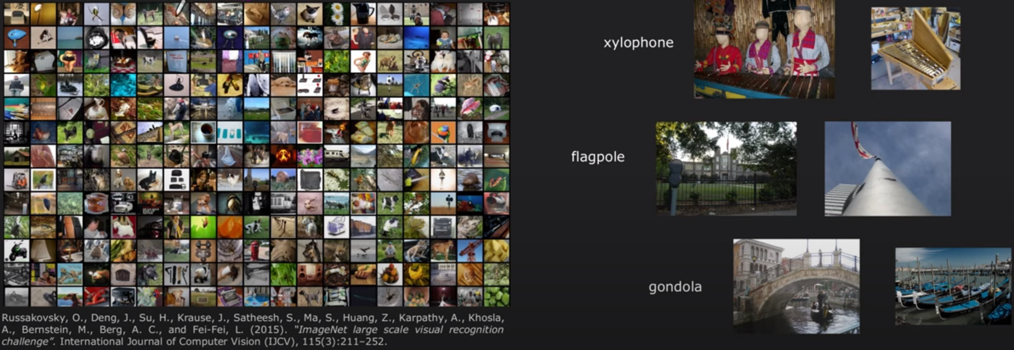
MiniImage Net 5-way 5-shot
Notes:
We also tested on a standard benchmark many few shot algorithms are demonstrated upon
MiniImageNet is a subset of the ImageNet dataset, containing images from 100 different classes and 600 images per class
In the context of few shot learning, N-way k-shot learning means the learner must learn to
classify N different classes with k provided examples from each class
Therefore for 5-way 5 shot task we chose 5 classes and sample 5 images from each of the 5 classes
And the few shot learner has to correctly identify the images

Slide 33
Benchmark techniques
Existing few shot learning/clustering algorithms used
UMTRA [6]
CACTUs-MAML [7]
Matching Nets [8]
MAML [9]
Meta Learn LSTM [10]
Centroid Networks [11]
K-nearest neighbors (KNN)
Our framework we refer as SCFC- Siamese Convolutional Few shot Clustering
Notes:
We have compared our technique with a variety of existing techniques
First is the UMTRA – Unsupervised meta learning for few shot image classification by Siavash (click)
Then we have CACTUs- Unsupervised learning via meta learning by Sergey Levines team (click)
Then we have Matching Nets- Matching networks for few shot learning by Vinyals (click)
Then we have MAML- Model-agnostic meta-learning for fast adaptation of deep networks by Levines team (click)
Then we have Meta Learn LSTM – Optimization as a model for few shot learning by Larochelle (click)
Then we have Centroid Networks - Centroid networks for few-shot clustering and unsupervised few-shot classification by Gabriel Huang (click)
Finally, we also took the features learn from our Siamese network in the light pretraining step and added a K nearest neighbor classifier to the end as a baseline
To serve as a replacement for the EM online adaptation clustering step devised by us.

Slide 34
Benchmark Techniques References
[6] Khodadadeh, Siavash, Ladislau Bölöni, and Mubarak Shah. "Unsupervised meta-learning for few-shot image classification." arXiv preprint arXiv:1811.11819 (2018).
[7] Hsu, Kyle, Sergey Levine, and Chelsea Finn. "Unsupervised learning via meta-learning." arXiv preprint arXiv:1810.02334 (2018).
[8] Vinyals, Oriol, et al. "Matching networks for one shot learning." arXiv preprint arXiv:1606.04080 (2016).
[9] Finn, Chelsea, Pieter Abbeel, and Sergey Levine. "Model-agnostic meta-learning for fast adaptation of deep networks." International Conference on Machine Learning. PMLR, 2017.
[10] Ravi, Sachin, and Hugo Larochelle. "Optimization as a model for few-shot learning." (2016).
[11] Huang, Gabriel, Hugo Larochelle, and Simon Lacoste-Julien. "Centroid networks for few-shot clustering and unsupervised few-shot classification." arXiv preprint arXiv:1902.08605 3.7 (2019).
Notes:
Ans here we have all the references for the different techniques used

Slide 35
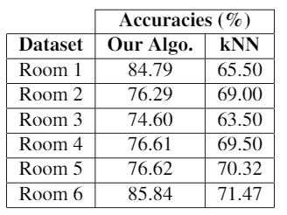
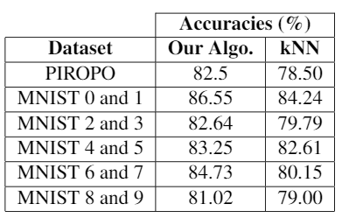
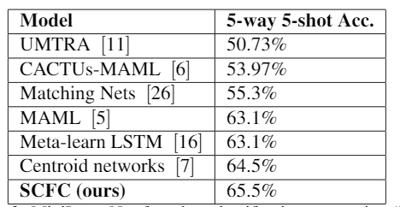
Benchmark results
Our occupancy detection dataset
MNIST pairwise and PIROPO
ImageNet 5-way 5-shot
Notes:
First, starting from the left-hand side, we our algorithm with the Knn baseline mentioned in the earlier slide over 6 different rooms
with different lighting conditions, occupancy rates and camera positions. In general, we observe an increase of accuracy
Of close to 10% on top of the light pretrained Siamese network when our clustering scheme is used.
In the center, we also compare across the PIROPO dataset and pairwise MNIST images, where we
Also see significant increase in accuracy
Finally, the whole lightly pretrained Siamese architecture + the EM clustering
Was tested alongside 6 previous existing few shot frameworks over the Image Net 5-way 5-shot benchmark,
And we obtained comparable accuracies

Slide 36
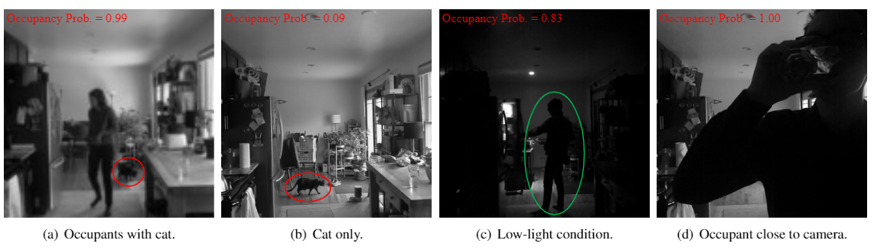
Robustness to different conditions
Notes:
We also tested our algorithm for better quality collected images
But with different conditions such as a pet cat present in the image
Extremely low light conditions
And in situations where the person can be very close to the camera
We found that the clustering is still able to correctly identify
And separate occupied instance from unoccupied instances
Sometimes in earlier literature review we had found out that pets might create problems
in occupancy detection especially when there are motion-based sensors installed,
however, in image-based occupancy sensing these problems might be avoided.

Slide 37
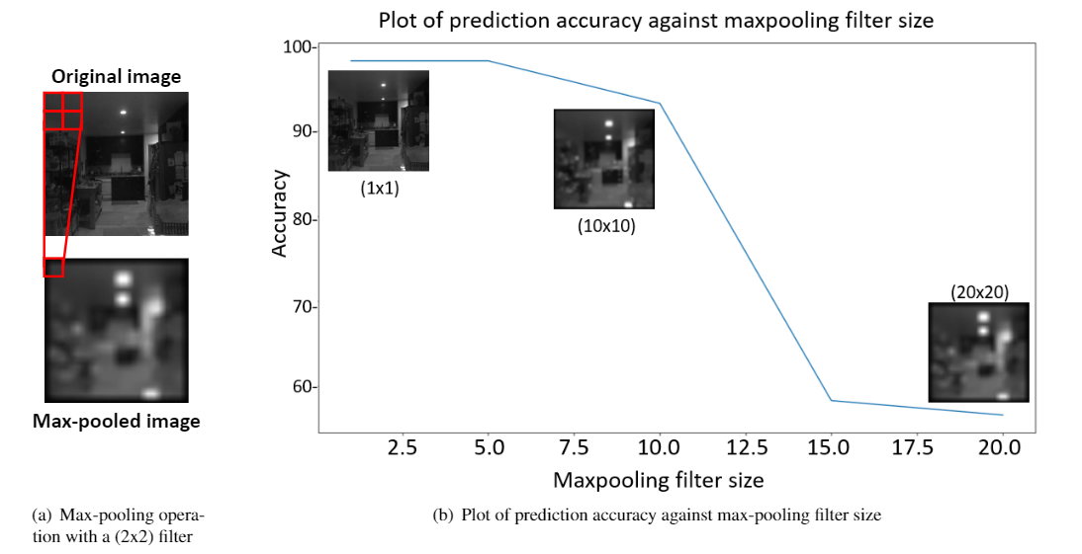
Privacy preserving factor- maxpooling window size
Notes:
We also tested the performance of our algorithm with respect to forced degradation of image quality in order to enhance privacy
In order to do that, we introduced maxpooling operation in collected images
Where each n by n region in the image is treated with a maxpooling filter picking
only the highest intensity pixel and distributing the average pixel value to the other pixels in the n by n region
We observe that upto a maxpool size of 10x10 which is shown in the left bottom image, considerable accuracies can be maintained
After which it rapidly starts detoriating and stays at around 60% accuracies.

Slide 38
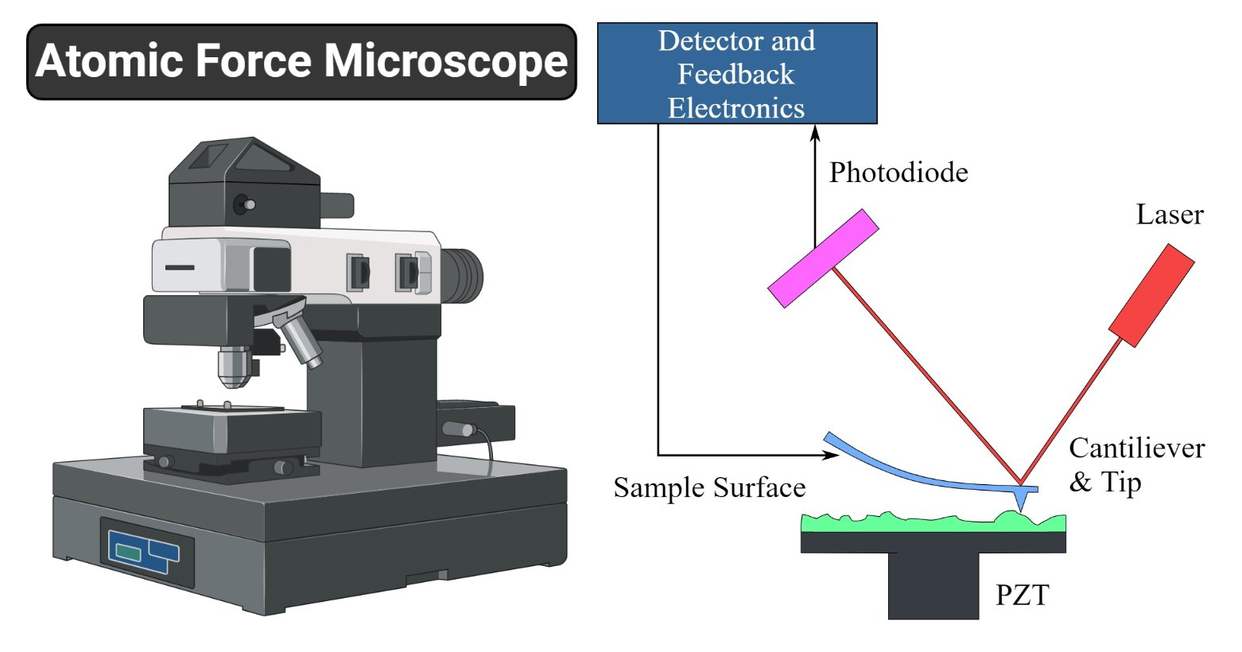
Future work
This few shot learning algorithm has been also applied in the domain of Atomic Force Microscopy for classification of force curves from minimal number of samples
Currently obtained results are being prepared for a journal submission
This algorithm can also be extended for fine grained classification tasks and would be helpful because annotated datasets for fine grained classification tasks are currently scarce.
Notes:
(read from slide)
(don’t read this below)
Currently we are trying to apply this algorithm in the domain of atomic force microscopy.
Our collaborators work on the problem of identifying molecular properties based of measurement of the
protein-protein interaction forces at a single molecular level.

Slide 39
List of courses
Computer graphics and geometric modeling (ME 557)
Theory of computation (COMS 531)
Machine Learning (COMS 573)
Advanced design and analysis of algorithms (COMS 511)
Principles of Artificial Intelligence (COMS 572)
Motion Strategy algorithms (COMS 576X)
Theory of Games and Uncertainty (COMS 634)
Concurrent Systems (COMS 572X)

Slide 40
Publication list (1/2)
Journals
H. Saha, A.R. Florita, G.P. Henze, & S. Sarkar. (2019). Occupancy sensing in buildings: A review of data analytics approaches. Energy and Buildings.
H. Saha, C. Liu, Z. Jiang, & S. Sarkar. (2019). Data driven performance monitoring of dynamical systems using Granger causal graphical models. ASME journal of Dynamics Measurement and Control.
T. Gao, H. Saha,H. Emadi, J. Zhang, A. Lofquist, A. Singh, B. Ganapathysubramanian, S. Sarkar, A. Singh, S. Bhattacharya. "A Novel Multirobot System for Plant Phenotyping." Robotics 7, no. 4 (2018): 61.
Notes:
List of courses needed

Slide 41
Publication list (2/2)
Conferences
H. Saha, V. Venkataraman, A. Speranzon, & S. Sarkar (2019). A perspective on multi-agent communication for information fusion. In 2019 VIGIL workshop NeurIPS.
H. Saha, S.Y. Tan, Z. Jiang, and S. Sarkar, 2019. “Learning state switching for multi sensor integration”. In 2019 Indian Control Conference (ICC), IEEE.
H. Saha, C. Liu, Z. Jiang, and S. Sarkar, Exploring granger causality in dynamical systems modeling and performance monitoring, Conference on Decision and Control, 2018.
H. Saha, T. Gao, H. Emadi, Z. Jiang, A. Singh, B. Ganapathysubramanian, S. Sarkar, A. Singh, S. Bhattacharya, "Autonomous Mobile Sensing Platform for Spatio-Temporal Plant Phenotyping." ASME 2017 Dynamic Systems and Control Conference. American Society of Mechanical Engineers, 2017.
S.Y. Tan, H. Saha, A.R. Florita, G.P. Henze, & S. Sarkar (2019, July). “A flexible framework for building occupancy detection using spatiotemporal pattern networks.” In 2019 American Control Conference (ACC) (pp. 5884-5889). IEEE.
S.Y. Tan, H. Saha, M. Jacoby, A.R. Florita, G.P. Henze, S. Sarkar (2020 February). “Granger causality based hierarchical time series clustering for state estimation”. Accepted for publication in International Federation for Automatic Control (IFAC) proceedings.
T. Gao, H. Emadi, H. Saha, J. Zhang, A. Lofquist, A. Singh, B. Ganapathysubramanian, S. Sarkar, A. Singh, and S. Bhattacharya. "Navigation Strategies for a Multi-Robot Ground-Based Row Crop Phenotyping Platform." In ASME 2018 Dynamic Systems and Control Conference. American Society of Mechanical Engineers Digital Collection, 2018.
Notes:
List of courses needed

Slide 42


Slide 43
Alternate clustering technique with same result (next 2 slides replacement for the E step)

Slide 44
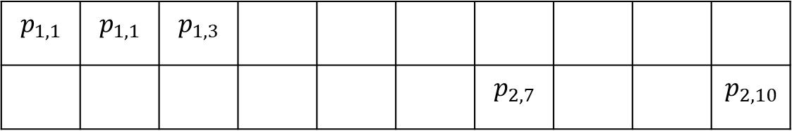



Few Shot Clustering Framework (E1-step)
Class 0
Unlabeled images
Labeled images
$p_{i,j}≥$row median | $x_{i,j}$ = 1
$p_{i,j}<$row median | $x_{i,j}$ = 0
$$p_{1,1}$$ | $$p_{1,1}$$ | $$p_{1,3}$$
 |  |  |  |  |  | $$p_{2,7}$$ |  |  | $$p_{2,10}$$
Class 1
Unlabeled images
Labeled images
$p_{i,j}≥$row median | $x_{i,j}$ = 1
$p_{i,j}<$row median | $x_{i,j}$ = 0
$$p_{1,1}$$ | $$p_{1,1}$$ | $$p_{1,3}$$
 |  |  |  |  |  | $$p_{2,7}$$ |  |  | $$p_{2,10}$$
Notes:
Finally for each similarity metric value calculated for a pair of images, we can again arrange then in form of
two probability tables for the two classes, pij denoting the probability value for each possible pairing
We get a table where each image from the labeled set is from class 0, and (click)
A table where each image from the labeled set is from the class 1
For each table, along the rows the values correspond to the same paired labeled image
And along the columns the values correspond to the same paired unlabeled image
Now each element in the table pij is substituted by the value xij according to the rule (click)
If the probability is greater than equal to the row median the assignment is 1, meaning similar
and if the probability less than the row median, the assignment is 0, meaning dissimilar

Slide 45


Few Shot Clustering Framework (E2-step assignment)
Class 0
Unlabeled images
Labeled images
$$x_{1,1}$$ | $$x_{1,1}$$ | $$x_{1,3}$$
 |  |  |  |  |  | $$x_{2,7}$$ |  |  | $$x_{2,10}$$
Class 1
Unlabeled images
Labeled images
$$x_{1,1}$$ | $$x_{1,1}$$ | $$x_{1,3}$$
 |  |  |  |  |  | $$x_{2,7}$$ |  |  | $$x_{2,10}$$
Notes:
After the assignments are complete in each table,
Now we simultaneously traverse both the tables column by column (click)
Values along each column are from pairings where all the pairs have the same unlabeled image.
If the mean x value for the unlabeled image is greater in the table for class 1, then a fictitious label of 1 is assigned to the unlabeled image
Conversely if the x value for the unlabeled image is greater in the table for class 0, then a fictitious label of 0 is assigned to the unlabeled image

